Slide 1
CMPE 277 Project Presentation -
Food Sharing App
By Jaspreet Singh
Project Group - 4
014638390

Slide 2
Motivation
The aim behind this project is to minimize the food wastage through sharing of food items. According to FDA , “In the United States alone, the food waste is estimated to be between 30-40 percent of food supply chain ( about $161 billions )” [1]
The application aims to connect the users having surplus food items with others who are in search for getting free food items.
The app is designed to be simple to use, intuitive and innovative.
[1] Source : https://www.fda.gov/food/consumers/food-loss-and-waste#:~:text=In%20the%20United%20States%2C%20food,worth%20of%20food%20in%202010.

Slide 3
Introduction
Food Sharing app is an android application
User needs to either sign up and create an account on the app or he can also use his google account to login within the app.
The user who wants to donate the food items can create an order by entering all the relevant details.
The other users who are looking for food items can go in the map view and search based on the cuisine filter. If there is a match, all the relevant order will be displayed on the map sorted by distance.

Slide 4
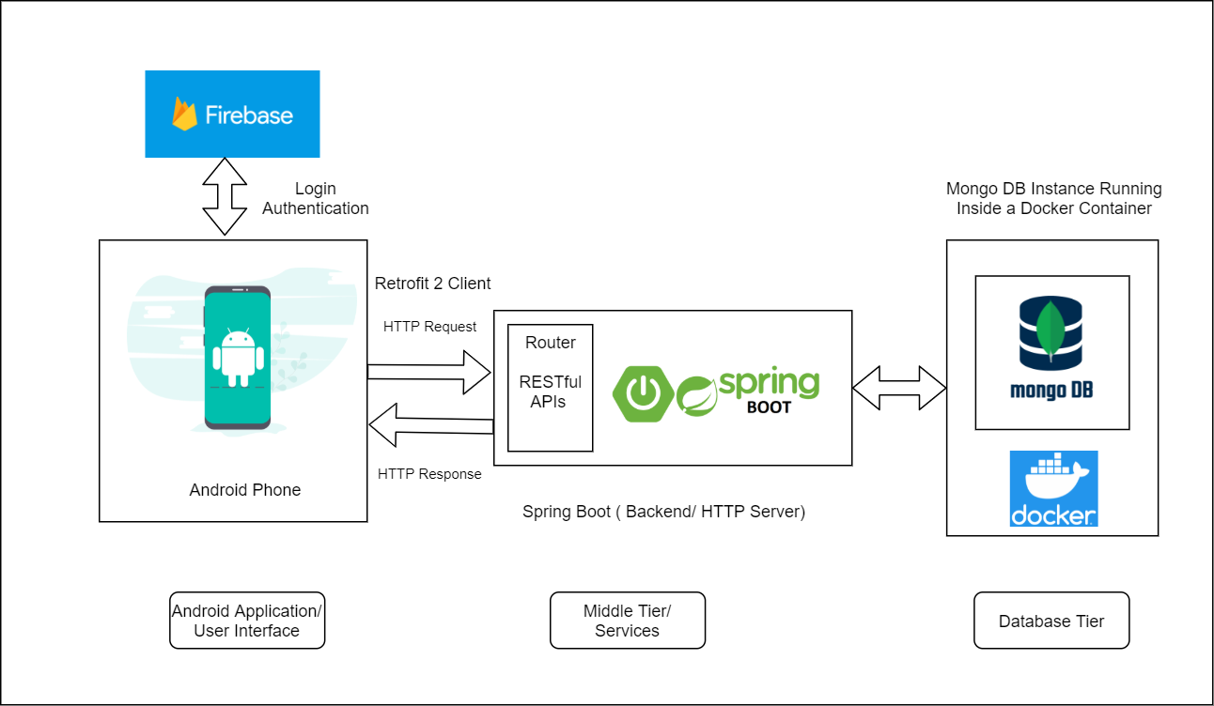
High Level Design

Slide 5
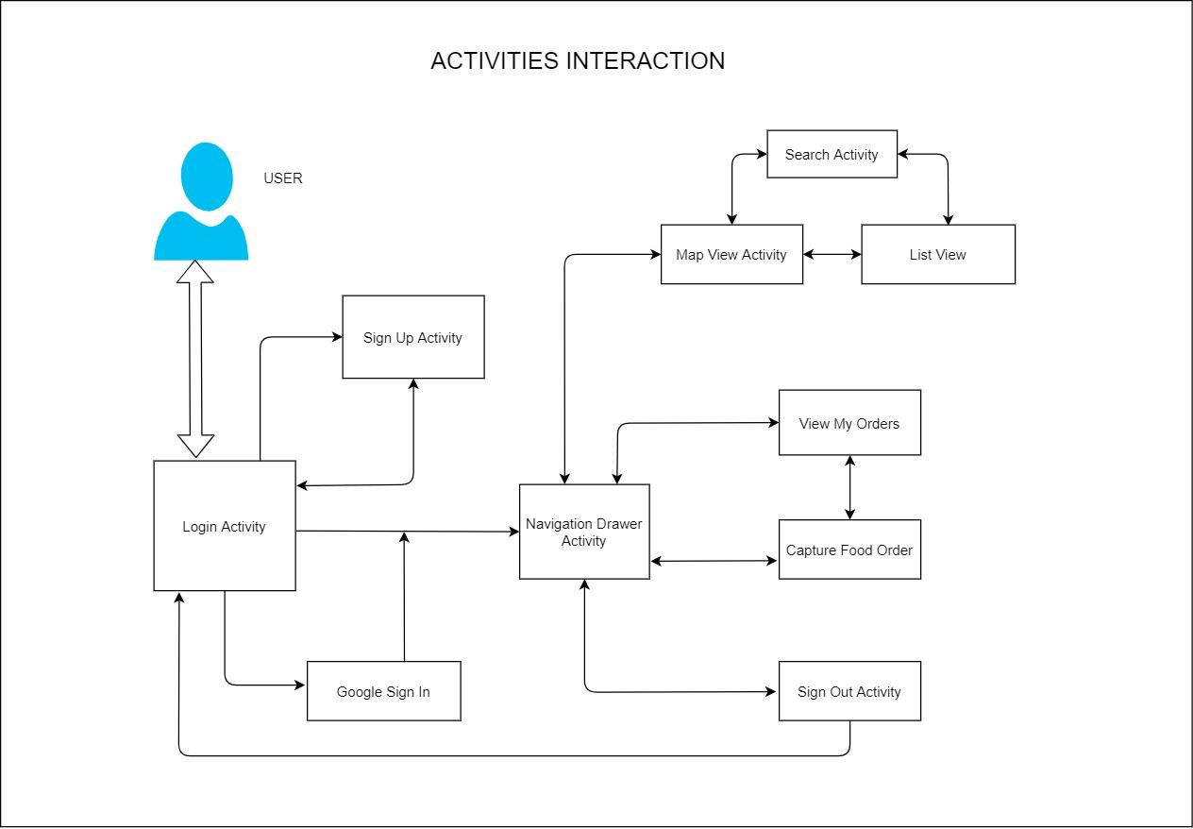
Activities Overview / Navigation

Slide 6
Database ( Model )
Food Order Model :
{
"id": "61845365d3eb64126f97a8a2",
"username": "jaspreet.singh03@sjsu.edu",
"name": "John Doe",
"foodType": "MEXICAN",
"quantity": 2,
"pickupDate": "11/05/2021",
"phoneNumber": "6692411234",
"address": "45248 Fremont Blvd, Fremont, CA 94538, USA",
"location": [ 5, 0, … ]
}
Note :- Initially I used SQLite to store the application data. But SQLite was only helpful to store the data locally. So, MongoDB is used to pool in all the food orders centrally. Also, the complete location is stored by marshalling and unmarshalling it using the parcelable plugin provided by android.

Slide 7
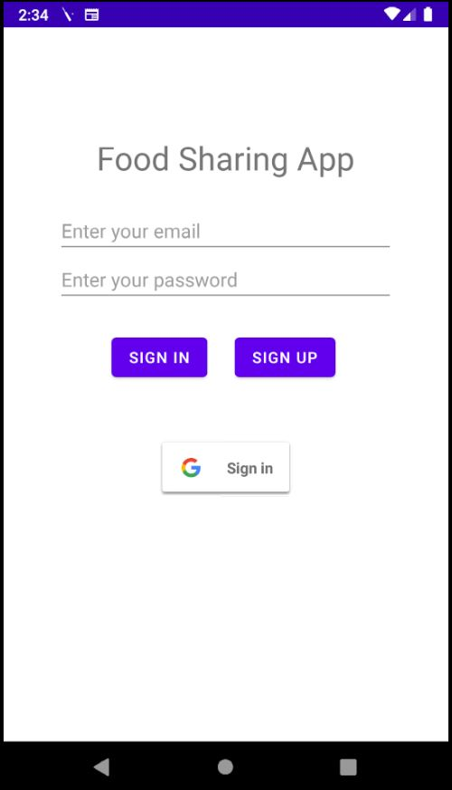
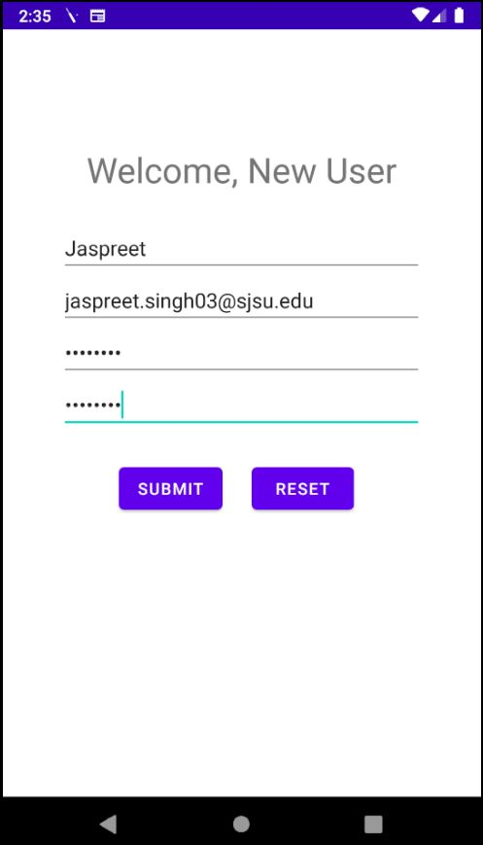
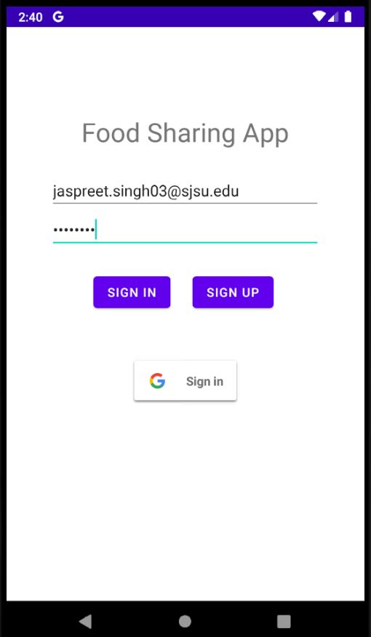
Login
Main Page
Sign Up
Login

Slide 8
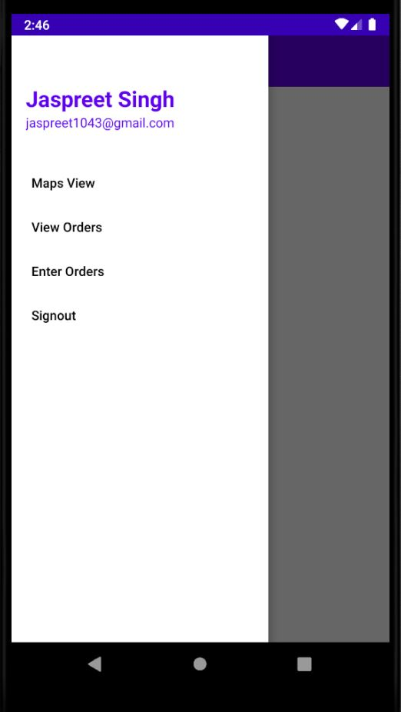
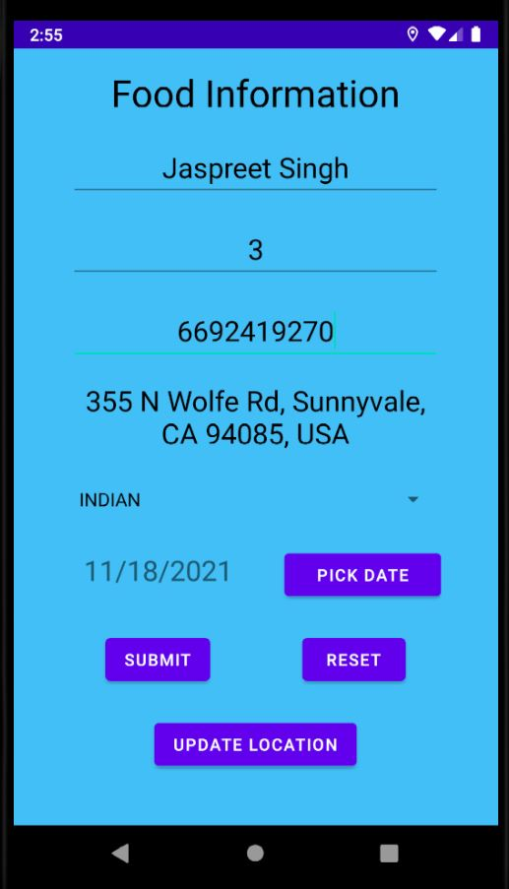
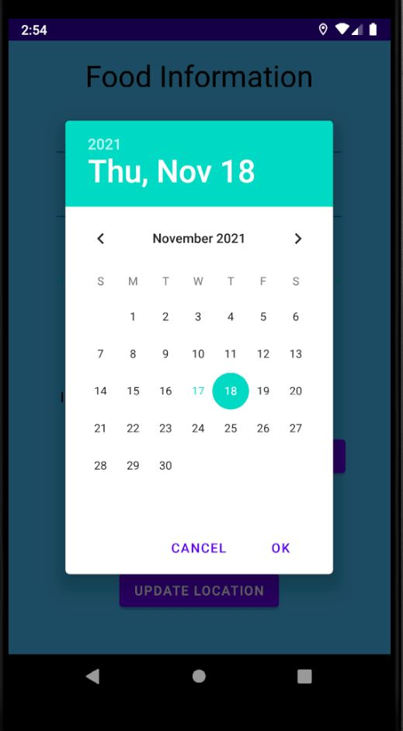
Navigation
Drawer

Slide 9
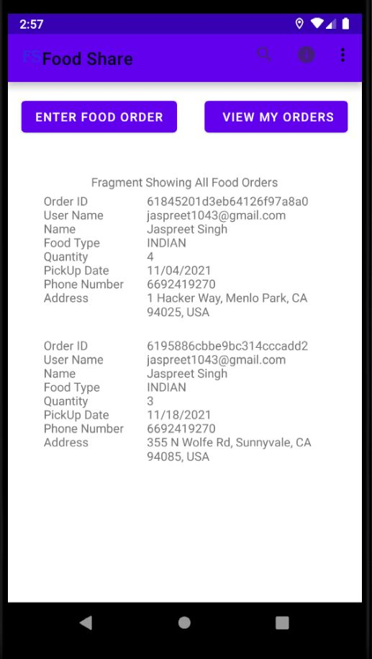
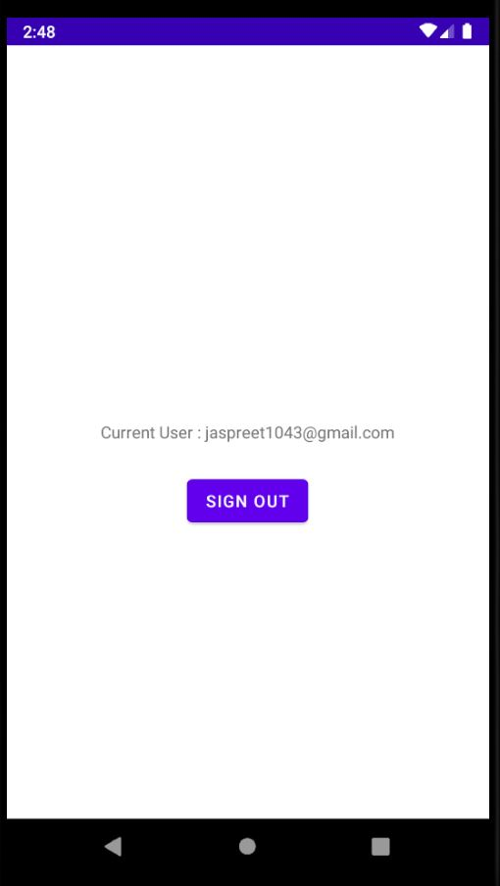
Navigation (contd)
Recycler View

Slide 10
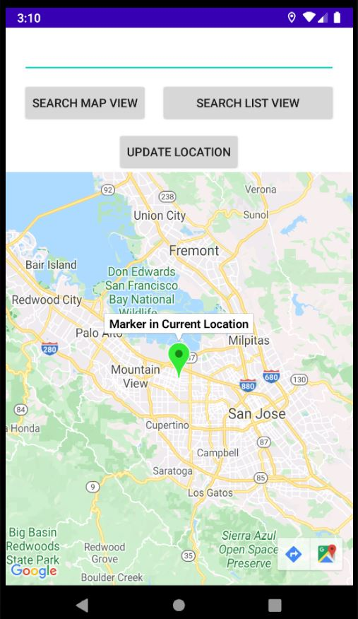
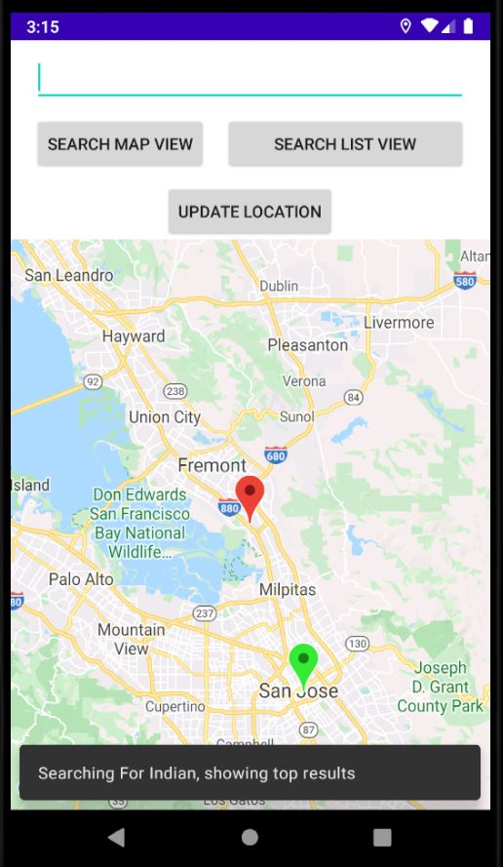
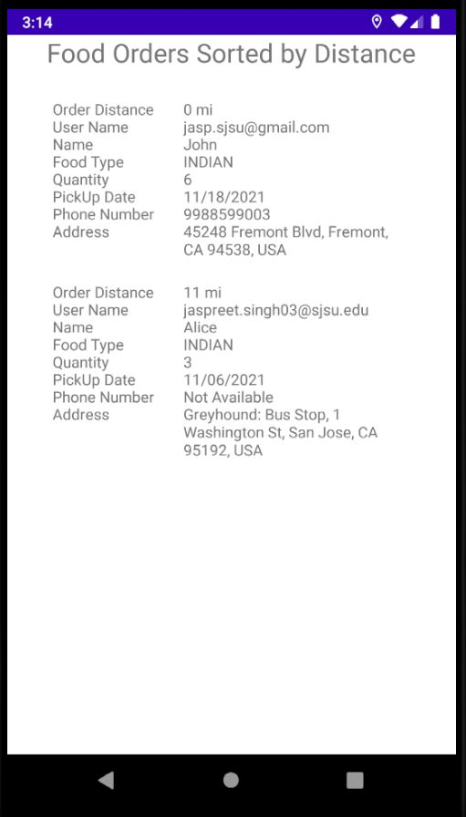
Map & List View
Current Location
Search List View

Slide 11
Learnings
Activities Lifecycle, Message Passing using Intents & Manifest
Creating Layouts and Widgets and their usage
Designing User Interface using Material Design Theme
Using SQLite to store the application data
Interacting With Google Maps and Locations
RecyclerView and using Fragments
Retrofit 2 (Http Client) API usage
Security Concepts using Firebase SDK
Serializing and deserializing the data using Parcelable plugin

Slide 12
Future Improvements
Improving and refining the User Interface
Enhancing the collected data to implement machine learning and create a recommendation system
Adding Payments and transactions so that users can even sell the food items at low prices, rather than giving it for free

Slide 13
Summary
The application connects the users having surplus food items that they don’t want to throw to wastage.
This app helps them to donate these food items by creating a food order with details like food serving size, contact details, pickup location and date of pickup.
Other users can sign in their account and using the Location-based search look up for these food items and pick them up from given location and pickup date.

Slide 14
Thank You ! Any Question ?

